Slide 1
Chapter 5
CPU Scheduling
Notes:
abbbb
cccc

Slide 2
Outline
Basic Concepts
Scheduling Criteria
Scheduling Algorithms
Multiple-Processor Scheduling
Real-Time Scheduling
Thread Scheduling
Operating Systems Examples
Java Thread Scheduling
Algorithm Evaluation
Notes:
abbbb
cccc

Slide 3
Basic Concepts
The idea of multiprogramming:
  Keep several processes in memory. Every time one process has to wait, another process takes over the use of the CPU
CPU-I/O burst cycle: Process execution consists of a cycle of CPU execution and I/O wait (i.e., CPU burst and I/O burst).
  Generally, there is a large number of short CPU bursts, and a small number of long CPU bursts.
  A I/O-bound program would typically has many very short CPU bursts.
  A CPU-bound program might have a few long CPU bursts
Notes:
abbbb
cccc

Slide 4

Alternating Sequence of CPU And I/O Bursts
Notes:
abbbb
cccc

Slide 5

Histogram of CPU-burst Times
(exponential or hyper-exponential)
Notes:
abbbb
cccc

Slide 6
CPU Scheduler
Selects from among the processes in memory that are ready to execute, and allocates the CPU to one of them
CPU scheduling decisions may take place when a process:
  1. Switches from running to waiting state
  2. Switches from running to ready state
  3. Switches from waiting to ready
  4. Terminates
Scheduling under 1 and 4 (no choice in terms of scheduling) is nonpreemptive
All other scheduling is preemptive
Notes:
abbbb
cccc

Slide 7
Diagram of Process State
interrupt
terminated
new
admitted
exit
ready
running
I/O or
event completion
scheduler dispatch
I/O or event wait
waiting
Notes:
abbbb
cccc

Slide 8
Preemptive Issues
Inconsistent cases may occur: preemptive scheduling incurs a cost associated with access to shared data
Affect the design of OS kernel: What happens if the process is preempted in the middle of critical changes (for instance, I/O queues) and the kernel (or the device driver) needs to read or modify the same structure?
  Unix solution: waiting either for a system call to complete or for an I/O block to take place before doing a context switch
  However, weak in supporting real-time computing and multiprocessing
Windows 95 and subsequent versions, Mac OS X
Notes:
abbbb
cccc

Slide 9
Dispatcher
Dispatcher module gives control of the CPU to the process selected by the short-term scheduler; this involves:
  switching context
  switching to user mode
  jumping to the proper location in the user program to restart that program
Dispatch latency – time it takes for the dispatcher to stop one process and start another running
Notes:
abbbb
cccc

Slide 10

Dispatch Latency
Notes:
abbbb
cccc

Slide 11
Scheduling Criteria
CPU utilization
  theoretically: 0%~100%
  real systems: 40% (light)~90% (heavy)
Throughput
  number of completed processes per time unit
Turnaround time (of a process)
  submission ~ completion
Waiting time (of a process)
  total waiting time in the ready queue
Response time (of a request)
  submission ~ the first response is produced
max
min
Notes:
abbbb
cccc

Slide 12
Scheduling Algorithms
first-come, first-served (FCFS) scheduling
shortest-job-first (SJF) scheduling
priority scheduling
round-robin scheduling
multilevel queue scheduling
multilevel feedback queue scheduling
Notes:
abbbb
cccc

Slide 13
Nonpreemptive or cooperative
The FCFS scheduling algorithm is nonpreemptive.
Once the CPU has been allocated to a process, that process keeps the CPU until it releases the CPU, either by terminating or by requesting I/O.

Slide 14
First-Come, First-Served Scheduling (1)
Simplest, non-preemptive, often having a long average waiting time
Example:
Process Burst Time
P1 24
P2 3
P3 3
P1
P2
P3
AWT = (0+24+27)/3
= 17
0 24 27 30
P2
P3
P1
AWT = (6+0+3)/3
= 3
0 3 6 30
Notes:
abbbb
cccc

Slide 15
First-Come, First-Served Scheduling (2)
Convoy effect: short process behind long process
  P1: a CPU bound process
  others: I/O bound
    P1 uses CPU, all others wait for CPU
        I/O devices idle
    P1 uses I/O, all others use CPU and then soon wait for I/O
        CPU idle
    P1 uses CPU, all others uses I/O and then soon wait for CPU
  lower CPU and I/O utilization
Notes:
abbbb
cccc

Slide 16
Shortest-Job First (SJF) Scheduling (1)
The smallest next CPU burst is selected
Provide the minimum average waiting time (optimal)
difficulty: no way to know length of the next CPU burst. Thus, it cannot be implemented in short-term scheduler
Process Burst Time
P1 6
P2 8
P3 7
P4 3
AWT = (3+16+9+0)/4
= 7
P4
P1
P3
P2
0 3 9 16 24
Notes:
abbbb
cccc

Slide 17

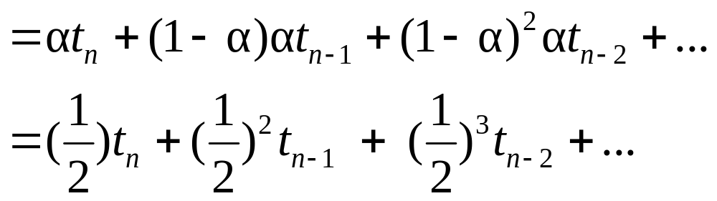
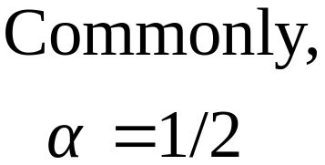
Frequently used in long-term scheduling
  A user is asked to estimate the job length. A lower value means faster response. Too low a value will cause timeout.
Approximate SJF: the next burst can be predicted as an exponential average of the measured length of previous CPU bursts
history
new one
Notes:
abbbb
cccc

Slide 18
Exponential predication of next CPU burst
burst length
12
10
8
6
4
2
time
CPU burst t_{n} t₀=6 4 6 4 13 13 13 ...
guess τ_{n} τ₀=10
8
6
6
5
9
11
12
Diff. 4 4 0 2 -8 -4 -2 ...
Notes:
abbbb
cccc

Slide 19
Shortest-Job First (SJF) Scheduling (2)
Two schemes
  nonpreemptive – once CPU given to the process it cannot be preempted until completes its CPU burst
  preemptive – if a new process arrives with CPU burst length less than remaining time of current executing process, preempt. This scheme is know as the
  Shortest-Remaining-Time-First (SRTF)
Notes:
abbbb
cccc

Slide 20
Example of Non-Preemptive SJF
Process Arrival Time Burst Time
P₁ 0.0 7
P₂ 2.0 4
P₃ 4.0 1
P₄ 5.0 4
SJF (non-preemptive)
Average waiting time = [0 + (8-2) + 3 + 7]/4 = 4
P₁
P₃
P₂
P₄
0
3
7
8
12
16
Notes:
abbbb
cccc

Slide 21
Example of Preemptive SJF
Process Arrival Time Burst Time
P₁ 0.0 7
P₂ 2.0 4
P₃ 4.0 1
P₄ 5.0 4
SJF (preemptive)
Average waiting time = [(16-7) + 1 + 0 +2]/4 = 3
P₁
P₂
P₃
P₂
P₄
P₁
0
2
4
5
7
11
16
Notes:
abbbb
cccc

Slide 22
Priority Scheduling
A priority number (integer) is associated with each process
The CPU is allocated to the process with the highest priority (smallest integer ≡ highest priority)
  Preemptive
  nonpreemptive
SJF is a priority scheduling where priority is the predicted next CPU burst time
Problem ≡ Starvation – low priority processes may never execute. (At MIT, there was a job submitted in 1967 that had not be run in 1973.)
Solution ≡ Aging – as time progresses increase the priority of the process
Notes:
abbbb
cccc

Slide 23
An Example
Process Burst Time Priority
P1 10 3
P2 1 1
P3 2 4
P4 1 5
P5 5 2
P2
P5
P4
P1
P3
0 1 6 16 18 19
AWT = (6+0+16+18+1)/5=8.2
Notes:
abbbb
cccc

Slide 24
Round Robin (RR)
Each process gets a small unit of CPU time (time quantum), usually 10-100 milliseconds. After this time has elapsed, the process is preempted and added to the end of the ready queue.
If there are n processes in the ready queue and the time quantum is q, then each process gets 1/n of the CPU time in chunks of at most q time units at once. No process waits more than (n-1)q time units.
Performance
  q large ⇒ FIFO
  q small ⇒ q must be large with respect to context switch, otherwise overhead is too high
Notes:
abbbb
cccc

Slide 25
Example of RR with Time Quantum = 20
Process Burst Time
P₁ 53
P₂ 17
P₃ 68
P₄ 24
The Gantt chart is:
Typically, higher average turnaround than SJF, but better response
P₁
P₂
P₃
P₄
P₁
P₃
P₄
P₁
P₃
P₃
0
20
37
57
77
97
117
121
134
154
162
Notes:
abbbb
cccc

Slide 26

Time Quantum and Context Switch Time
Notes:
abbbb
cccc

Slide 27

Turnaround Time Varies With The Time Quantum
5 3 1 5 1 2
15+
8+
9+
17 = 49
49/4 = 12.25
Notes:
abbbb
cccc

Slide 28
Multilevel Queue
Ready queue is partitioned into separate queues:
foreground (interactive)
background (batch)
Each queue has its own scheduling algorithm,
foreground – RR
background – FCFS
Scheduling must be done between the queues.
  Fixed priority scheduling; (i.e., serve all from foreground then from background). Possibility of starvation.
  Time slice – each queue gets a certain amount of CPU time which it can schedule amongst its processes; i.e.,
    80% to foreground in RR
    20% to background in FCFS
Notes:
abbbb
cccc

Slide 29

Multilevel Queue Scheduling
Notes:
abbbb
cccc

Slide 30
Multilevel Feedback Queue
A process can move between the various queues; aging can be implemented this way
Multilevel-feedback-queue scheduler defined by the following parameters:
  number of queues
  scheduling algorithms for each queue
  method used to determine when to upgrade a process
  method used to determine when to demote a process
  method used to determine which queue a process will enter when that process needs service
Notes:
abbbb
cccc

Slide 31
Example of Multilevel Feedback Queue
Three queues:
  Q₀ – time quantum 8 milliseconds
  Q₁ – time quantum 16 milliseconds
  Q₂ – FCFS
Scheduling
  A new job enters queue Q₀ which is served FCFS. When it gains CPU, job receives 8 milliseconds. If it does not finish in 8 milliseconds, job is moved to queue Q₁.
  At Q₁ job is again served FCFS and receives 16 additional milliseconds. If it still does not complete, it is preempted and moved to queue Q₂.
Notes:
abbbb
cccc

Slide 32

Multilevel Feedback Queues
Notes:
abbbb
cccc

Slide 33
Multiple-Processor Scheduling
Notes:
abbbb
cccc

Slide 34
Approaches to Multiple-Processor Scheduling
Asymmetric Multiprocessing: All scheduling decisions, I/O processing, and other system activities handled by a single processor- master server.
Symmetric Multiprocessing (SMP): Each processor is self-scheduling. All processes may be in a common ready queue, or each processor may have its own private queue of ready processes.

Slide 35
Processor Affinity
Avoid migration of processes from one processor to another and instead attempt to keep a process running on the same processor. This is known as processor affinity.
i.e. a process has an affinity for the processor on which it is currently running.

Slide 36
Types of Affinity
Soft affinity: It is possible for a process to migrate between processors.
Hard affinity: Allowing a process to specify that it is not to migrate to other processors.

Slide 37
Multiple-Processor Scheduling
Only homogeneous systems are discussed here
Scheduling
  1. Each processor has a separate queue
  2. All processes use a common ready queue
  a. Each processor is self-scheduling
  b. Appoint a processor as scheduler for the
  other processes (the master-slave structure)
Load sharing: Push migration, Pull migration
Asymmetric multiprocessing: all system activities are handled by a processor, the others only execute user code (allocated by the master), which is far simple than symmetric multiprocessing (SMP, SMT(hyperthreading: one CPU, multi-logical processors))
Processor affinity: a process has an affinity for the processor on which it is currently running
Cache memory
validating
Keep running on the same processor
Notes:
abbbb
cccc

Slide 38
Real-Time Scheduling (1)
Hard real-time systems – required to complete a critical task within a guaranteed amount of time
  Resource reservation is needed
  special purpose software on dedicated HW
Soft real-time computing – requires that critical processes receive priority over less fortunate ones
Notes:
abbbb
cccc

Slide 39
Real-Time Scheduling (2)
Scheduler for soft real-time system
Priority scheduling (real-time process must have the highest priority). Easy!
The dispatch latency must be small
  Problem: Most OS waits a system call to complete (or I/O block to take place) before doing context switch
Solution: system calls should be pre-emptible
  Insert preemption points in long-duration system calls (The latency is still long, there are a few preemption points.)
  Make the entire kernel preemptible
Notes:
abbbb
cccc

Slide 40
Real-Time Scheduling (3)
Make the entire kernel preemptible
  All kernel data structure used by lower-priority must be protected from modification by high-priority process.
  Problem: priority inversion (A higher-priority process is waiting for a lower-priority one to finish and release some resources)
  Solution: priority inheritance protocol (all lower-priority processes inherit the high priority until they are done with the resource in question.)
Notes:
abbbb
cccc

Slide 41
Thread Scheduling
User-level threads are managed by a thread library, and the kernel is unaware of them. To run on a CPU, user-level threads are ultimately mapped to an associated kernel-level thread, or LWP.
  Process local scheduling: Thread scheduling is done local to the application. The threads library schedules user-level threads to run on an available LWP
  How different threads library locally schedule threads is beyond this course. We omit the discussion here.
  System global scheduling: The kernel decides which kernel thread to schedule
Notes:
abbbb
cccc

Slide 42
Pthread Scheduling API
#include <pthread.h>
#include <stdio.h>
#define NUM_THREADS 5
int main(int argc, char *argv[])
{
int i;
pthread_t tid[NUM_THREADS];
pthread_attr_t attr;
/* get the default attributes */
pthread_attr_init(&attr);
/* set the scheduling algorithm to PROCESS or SYSTEM */
pthread_attr_setscope(&attr, PTHREAD_SCOPE_SYSTEM);
/* set the scheduling policy - FIFO, RT, or OTHER */
pthread_attr_setschedpolicy(&attr, SCHED_OTHER);
/* create the threads */
for (i = 0; i < NUM_THREADS; i++)
pthread_create(&tid[i],&attr,runner,NULL);
Notes:
abbbb
cccc

Slide 43
Pthread Scheduling API
/* now join on each thread */
for (i = 0; i < NUM THREADS; i++)
pthread_join(tid[i], NULL);
}
/* Each thread will begin control in this function */
void *runner(void *param)
{
printf("I am a thread\n");
pthread_exit(0);
}
Notes:
abbbb
cccc

Slide 44
Operating System Examples
Solaris scheduling
Windows XP scheduling
Linux scheduling
Notes:
abbbb
cccc

Slide 45
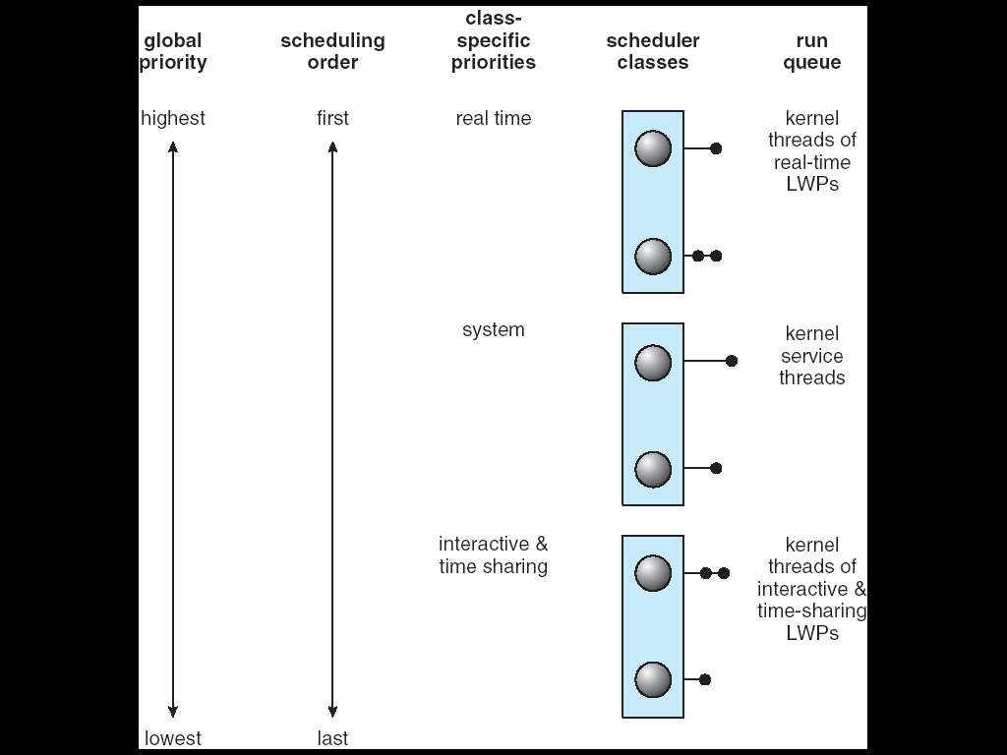
Solaris 2 Scheduling (1) priority-based scheduling
Notes:
abbbb
cccc

Slide 46
Solaris 2 Scheduling (2)
Four classes of scheduling: real-time -> system -> time sharing -> interactive.
A process starts with one LWP and is able to create new LWPs as needed. Each LWP inherits the scheduling class and priority of the parent process. Default : time sharing (multilevel feedback queue)
Inverse relationship between priorities and time slices: the high the priority, the smaller the time slice.
Interactive processes typically have a higher priority; CPU-bound processes have a lower priority.
Notes:
abbbb
cccc

Slide 47
Solaris 2 Scheduling (3)
Uses the system class to run kernel processes, such as the scheduler and page daemon. The system class is reserved for kernel use only.
Threads in the real-time class are given the highest priority to run among all classes.
There is a set of priorities within each class. However, the scheduler converts the class-specific priorities into global priorities. (round-robin queue)
Notes:
abbbb
cccc

Slide 48

Solaris Dispatch Table
Notes:
abbbb
cccc

Slide 49

Windows XP Priorities
Notes:
abbbb
cccc

Slide 50
Linux Scheduling – preemptive & priority
Version 2.5: support SMP, Load balancing & Processor affinity
Time-sharing (100-140) and Real-time (0-99)
Higher priority with longer time quanta
Time-sharing
  Prioritized credit-based – process with most credits is scheduled next
  Credit subtracted when timer interrupt occurs
  When credit = 0, another process chosen
  When all processes have credit = 0, recrediting occurs
    Based on factors including priority and history
Real-time
  Soft real-time
  Posix.1b compliant – two classes
    FCFS and RR
    Highest priority process always runs first
Notes:
abbbb
cccc

Slide 51

The Relationship Between Priorities and Time-slice length
Notes:
abbbb
cccc

Slide 52

List of Tasks Indexed According to Prorities
Notes:
abbbb
cccc

Slide 53
Java Thread Scheduling (1)
Preemptive, priority-based scheduling (FIFO queue)
Time slicing:
  Java does not indicate whether or not threads are time-sliced or not – it is up to the particular implementation of the JVM.
  All threads have an equal amount of CPU time on a system that does not perform time slicing, a thread may yield control of the CPU with the yield() method. Cooperative multitasking.
  Thread.yield();
Notes:
abbbb
cccc

Slide 54
Java Thread Scheduling (2)
Thread priorities:
  Threads are given a priority when they are created and – unless they are changed explicitly by the program – they maintain the same priority throughout their lifetime; the JVM does not dynamically alter priorities.
  The priority of a thread can also be set explicitly with the setPriority() method. The priority can be set either before a thread is started or while a thread is active.
Java-Based Round-robin Scheduler
Notes:
abbbb
cccc

Slide 55
Time-Slicing
Since the JVM Doesn’t Ensure Time-Slicing, the yield() Method
May Be Used:
while (true) {
// perform CPU-intensive task
. . .
Thread.yield();
}
This Yields Control to Another Thread of Equal Priority
Notes:
abbbb
cccc

Slide 56
Thread Priorities
Priority Comment
Thread.MIN_PRIORITY Minimum Thread Priority
Thread.MAX_PRIORITY Maximum Thread Priority
Thread.NORM_PRIORITY Default Thread Priority
Priorities May Be Set Using setPriority() method:
setPriority(Thread.NORM_PRIORITY + 2);
Notes:
abbbb
cccc

Slide 57
Algorithm Evaluation
Criteria to select a CPU scheduling algorithm may include several measures, such as:
  Maximize CPU utilization under the constraint that the maximum response time is 1 second
  Maximize throughput such that turnaround time is (on average) linearly proportional to total execution time
Evaluation methods ?
  deterministic modeling
  queuing models
  simulations
  implementation
Notes:
abbbb
cccc

Slide 58
Deterministic modeling (1)
Analytic evaluation
  Input: a given algorithm and a system workload to
  Output: performance of the algorithm for that workload
Deterministic modeling
  Taking a particular predetermined workload and defining the performance of each algorithm for that workload.
Notes:
abbbb
cccc

Slide 59
Deterministic modeling (2)
FCFS
SJF
RR (q = 10)
Process Burst Time
P1 10
P2 29
P3 3
P4 7
P5 12
P1
P2
P3
P4
P5
AWT = 28 ms
0 10 39 42 49 61
P3
P4
P1
P5
P2
AWT = 13 ms
0 3 10 20 32 61
P1
P2
P3
P4
P5
P2
P5
P2
AWT = 23 ms
0 10 20 23 30 40 50 52 61
Notes:
abbbb
cccc

Slide 60
Deterministic modeling (3)
☺: A simple and fast method. It gives the exact numbers, allows the algorithms to be compared.
☹: It requires exact numbers of input, and its answers apply to only those cases. In general, deterministic modeling is too specific, and requires too much exact knowledge, to be useful.
Usage
  Describing algorithm and providing examples
  A set of programs that may run over and over again
  Indicating the trends that can then be proved
Notes:
abbbb
cccc

Slide 61
Queuing Models (1)
Queuing network analysis
  Using
    the distribution of service times (CPU and I/O bursts)
    the distribution of process arrival times
  The computer system is described as a network of servers. Each server has a queue of waiting processes.
  Determining
    utilization, average queue length, average waiting time, and so on
Notes:
abbbb
cccc

Slide 62
Queuing Models (2)
Little's formula (for a stable system):
n = λ × W
Queuing analysis can be useful in comparing scheduling algorithms, but it also has limitations.
☹: Queue model is only an approximation of a real system. Thus, the result is questionable.
  The arrival and service distributions are often defined in unrealistic, but mathematically tractable, ways.
  Besides, independent assumptions may not be true.
14 persons in queue =
7 arrives/per second ×
2 seconds waiting
  λ : average arrival rate
  n : average queue length
queue
server
W: average waiting time
Notes:
abbbb
cccc

Slide 63
Simulations
Simulations involve programming a model of the system. Software data structures represent the major components of the system.
☺: Simulations get a more accurate evaluation of scheduling algorithms.
☹: 1. expensive (several hours of computer time).
    2. large storage
    3. coding a simulator can be a major task
Generating data to drive the simulator
  a random number generator.
  trace tapes: created by monitoring the real system, recording the sequence of actual events.
Notes:
abbbb
cccc

Slide 64

Evaluation of CPU Schedulers by Simulation
Notes:
abbbb
cccc

Slide 65
Implementation
Put data into a real system and see how it works.
☺: The only accurate way
☹: 1. cost is too high
    2. environment will change (All methods have this problem!)
      e.g., To avoid moving to a lower priority queue, a user may output a meaningless char on the screen regularly to keep itself in the interactive queue.
Notes:
abbbb
cccc

Slide 66
SMT: Symmetric Multithreading
Hyper-threading technology (HTT), intel©
  providing useful work for execution units that would otherwise be idle, for example during a cache miss, or branch misprediction.
SMP: Allow several threads to run concurrently by providing multiple physical processors (PPs).
SMT: … providing multiple logical processors (LPs).
Each LP has its own architecture state, including general-purpose and machine-state registers.
  LP is responsible for its own interrupt handling
SMT is a feature provided by H/W (state, interrupt handling), not S/W.
  Certain performance gain are possible if OS is aware that.
  e.g., Consider a system with two PPs, both are idle. The scheduler should first try scheduling separate threads on each PP rather than on separate LPs on the same PP.
Notes:
abbbb
cccc

Slide 67
Homework 3
Reading Assignment
  Bibliographical Notes
Written Assignment
  Problems:
Due:
Notes:
abbbb
cccc

